Slide 1
Threshold Compression for
3G Scalable Monitoring
Suk-Bok Lee, Dan Pei, MohammadTaghi Hajiaghayi, Ioannis Pefkianakis
Songwu Lu, He Yan, Zihui Ge, Jennifer Yates, Mario Kosseifi
CMU AT&T Labs-Research UCLA
U of Maryland AT&T Network Services
Notes:
In this work, we study the problem of scalable monitoring of operational 3G networks.

Slide 2
What’s unique challenges on 3G network monitoring?
A large number of network elements (NEs)
  E.g. several thousands cell-sites in a single market area
  Different-types of NEs:
    GGSN - SGSN - RNC - NodeB – Sector
  Various KPIs (key performance metrics)
Dynamics on measurement results
  Both in time and spatial domains
  Reflecting:
    Mobile user’s daily 3G usage pattens
    Cell-site physical location & network topology
Notes:
3G network monitoring is challenging, mainly due to two main factors: large network scale and dynamics in both time and spatial domains.
First, massive data collected from a large number of network elements can easily overwhelm a standard monitoring tool.
For ex, there are usually more than several 1000s of cell sites in a single market, and there are a number of different KPIs to monitor at each NE.
Second, 3G networks exhibit richer dynamics in both temporal and spatial domains compared with their wired counterparts.
User-perceived performance tends to vary over time and at different locations, reflecting the human activity over time and mobility-induced service diversity across geographic areas. Consequently, capturing sustained service impairments while ignoring inherent service fluctuations at each NE at runtime becomes important for 3G network monitoring.

Slide 3
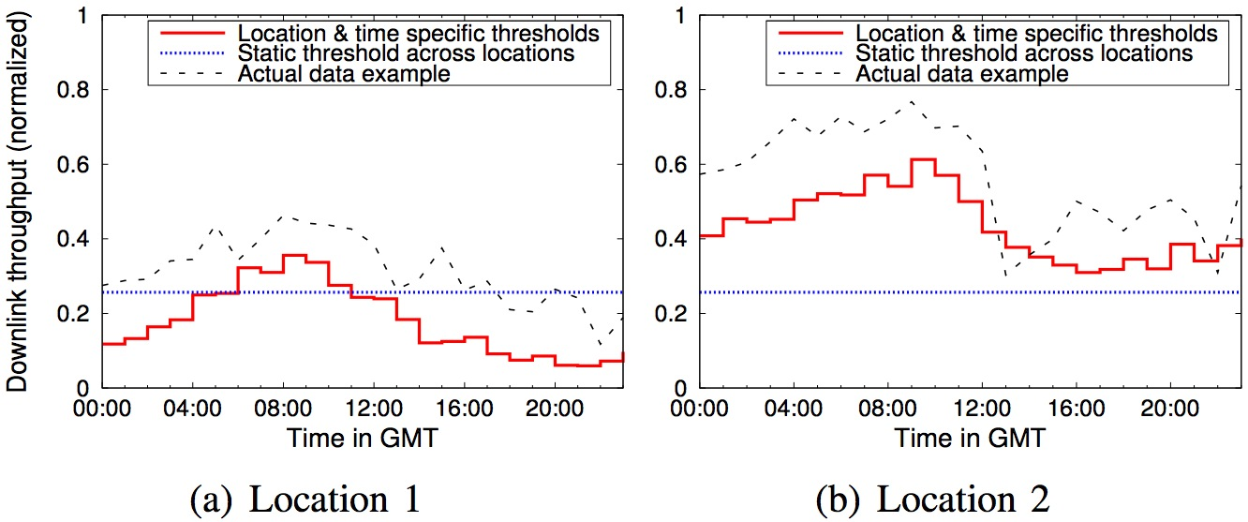
Naïve threshold-based alarming model is not scalable to large 3G networks
Single static threshold (across locations): poor alarm quality
Fine-grained threshold (location & time specific): management complexity
Notes:
The current monitoring practice is to use pre-defined thresholds of selected key performance indicator (KPI) metrics.
However, direct application of such a threshold-based alarming model does not scale in 3G networks due to the two factors identified above.
These figures show DL-throughput threshold examples of different NEs based on their historical data.
A single representative static threshold (blue dotted line) fails to capture the spatial and temporal dynamics, leading to many false and miss alarms (with nearly 70% false positives/negatives).
On the other hand, a finer-grained location- and time-dependent threshold setting (red line) can capture network dynamics but it can incur prohibitively high system management complexity.

Slide 4
Possible thresholding schemes with different monitoring granularity
Per-NE-hourly (fine-grained location & time dependent)
  Each NE has its own hourly thresholds
Per-NE-static
  Each NE has a single (aggregating all hours) threshold
Per-NEtype-hourly
  Every NE shares the same hourly (aggregating all NEs) thresholds
Per-NEtype-static
  A single threshold (aggregating all hours and all NEs)
Notes:
So, we can consider several possible thresholding schemes with different monitoring granularity.
The thresholds are pre-computed based on the the historical data, and here we consider four representative schemes:
per-NE-hourly is fine-grained location and time dependent thresholding. The threshold pre-computation is performed for each individual NE for each hour so as to capture the performance trends on specific location and hour.
per-NE-static: The thresholds are computed individual-NE based (with aggregating all hours) and thus, each NE has a single (location- specific) threshold value per KPI
per-NEtype-hourly: The thresholds are computed for each hour (with aggregating all NEs of the same type) such that hourly thresholds are applied to all NEs
per-NEtype-static: The threshold is computed via aggregating all hours and all NEs of the same type, thus resulting in a single threshold per KPI.

Slide 5
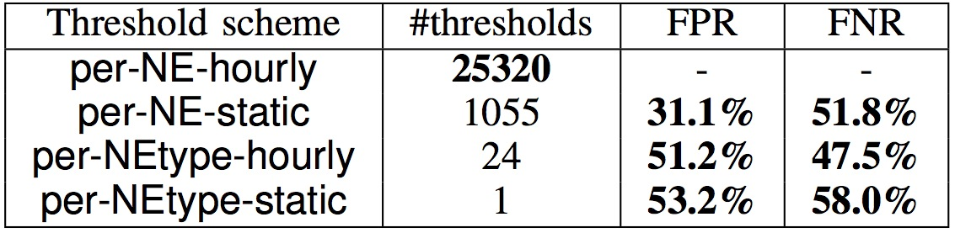
None of them are scalable to 3G monitoring
Thresholding on DL-throughput in a single area
(2010/06 - 2010/10)
Per-NE-hourly
  ideal for capturing dynamic 3G characteristics
  threshold size per KPI grows very large with network size
Aggregate-based threshold schemes
  small threshold settings
  high FPR (false positive rate) and FNR (false negative rate)
Notes:
However, all of them has scaling difficulties for monitoring a large 3G network.
This table shows the number of thresholds and their alarm quality (false positive/false negative rates) of each scheme when monitoring a single KPI (DL-tput) in a single area.
Per-NE-hourly thresholding is ideal for monitoring the dynamic nature of 3G network characteristics, thus we use it as ground-truth for other schemes. However, the number of thresholds to be maintained per KPI grows very large with the number of NEs in the monitoring area.
On the other hand, the other aggregate-based threshold schemes have small threshold settings, but all result in very poor alarm quality.

Slide 6
Fundamental tradeoff: threshold setting vs. alarm quality
Fine-grained spatial-temporal thresholds
  Pros: good alarm quality
    Capture well each NE’s location and time specific behavior
  Cons: large # of thresholds, management complexity
    E.g. a single area has >30,000 thresholds per KPI
Aggregate-based thresholds
  Pros: a single threshold value for all NEs and hours
    low system management overhead
  Cons: poor alarm quality
    E.g. can be observed ~70% false positive/false negatives
Can we have both advantages (small threshold settings and good alarm quality) in a large 3G network?
Notes:
So, the main problem is that there’s tradeoff between threshold setting size and resulting alarm quality.
As seen from previous slide, for ex, fine-grained thresholds can capture well each NE’s location and time specific behavior, but it incurs large # of thresholds, which can become management complexity. For ex. In our dataset, this threshold scheme needs more than 30K thresholds for a single KPI in single area.
On the other extreme side, aggregate-based threshold schemes have very small threshold settings, but result in unacceptably poor alarm quality
So, now our question is “can we have both merits of small threshold setting and good alarm quality for monitoring a large 3G network?”

Slide 7
Our solution: threshold compression
Intelligent threshold aggregation
  Observation 1:
    Some group of NEs show similar threshold behaviors
    → threshold aggregation via NE grouping
  Observation 2:
    Certain group of hours show similar threshold behaviors
    → threshold aggregation via hourly grouping
Our threshold-compression
  characterizes the location- and time-specific threshold trend of each NE with minimal threshold setting
  Maintains acceptable alarm accuracy
Notes:
Our solution is to aggregate thresholds intelligently.
The main insight for our solution is that, although each NE has its own spatial and temporal thresholding behavior,
such dynamic trend is not completely unique across locations and across time.
In other words, a certain group of NEs show quite similar threshold behavior, and they can lead to NE grouping.
Also, some period of times show quite similar threshold behavior, and they can lead to hourly grouping.
In this way, our threshold-compression identifies such similar groups of NEs and hours, and forms spatial-temporal clusters
to have a small threshold setting while maintaining good alarm quality for large-scale 3G network monitoring.

Slide 8
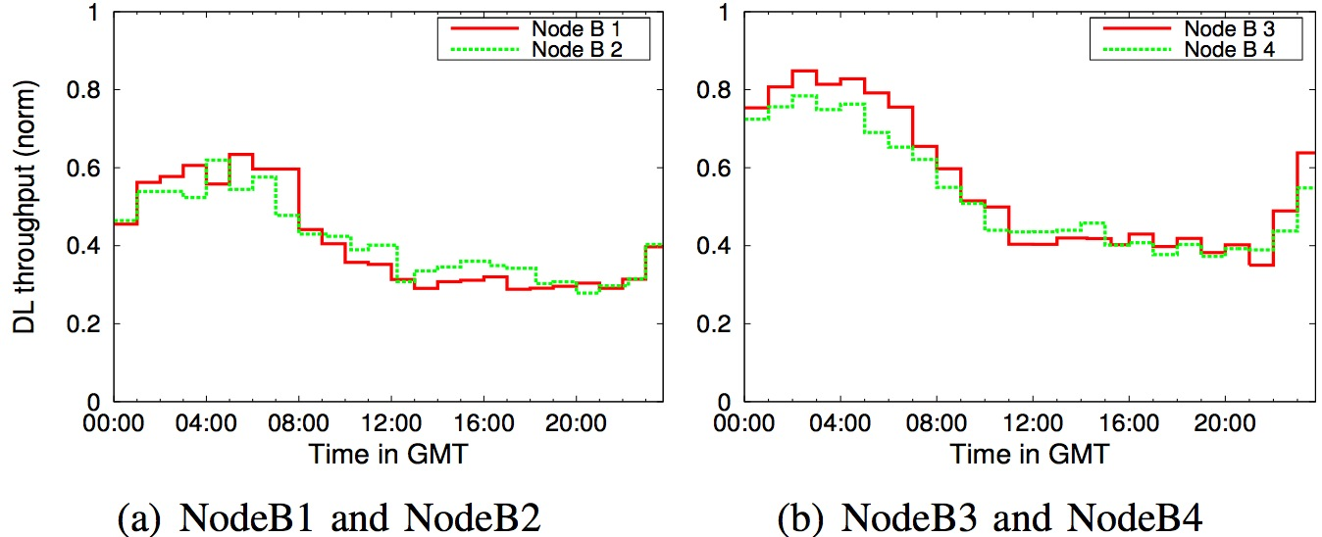
Observation of similar threshold behavior
Spatial-domain similarity
  Geographic locations & user population around NEs
Time-domain similarity
  Daily trend of 3G usage pattern
Notes:
These figures show example of similar DL-tput thresholding behaviors across different NEs.
Here, NodeBs in each figure show very similar behaviors.
This similarity can be explained in both spatial and time domains.
This spatial similarity is attributed to the geographic locations of NEs and the user population in the corresponding area.
For example, NEs in the same metropolitan area are likely to have similar high demand (competing cell capacity with more users).
Time-domain similarity is more evident and easier to understand. The clear daily trend is attributed to the users’ 3G usage pattern, likely following the diurnal pattern of human activity.

Slide 9
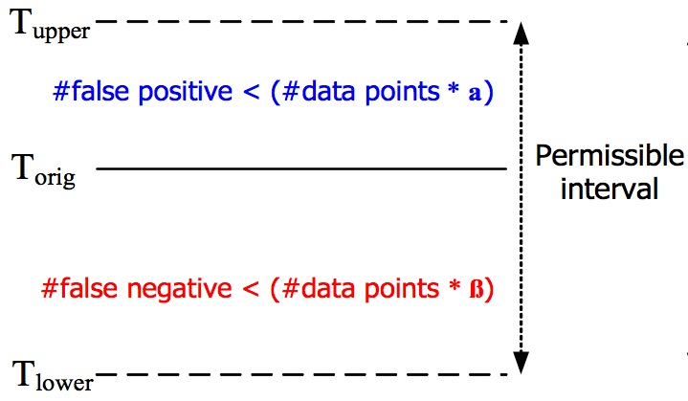
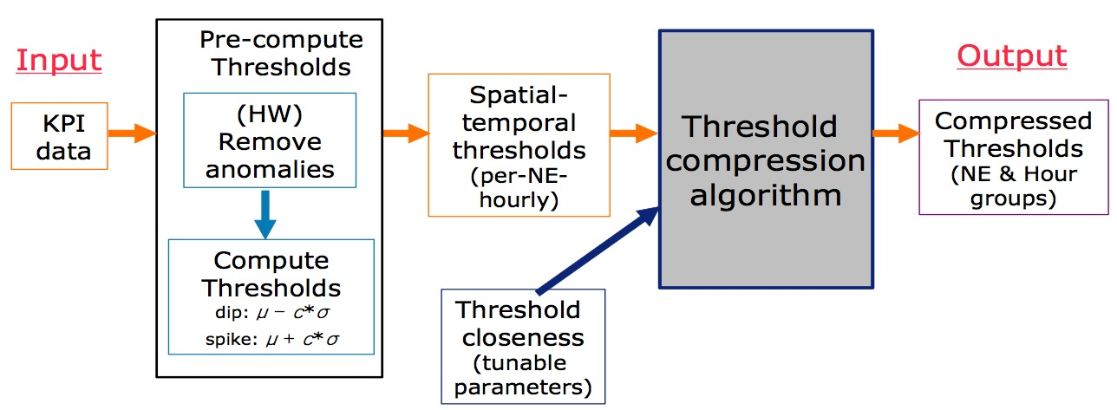
Desirable properties of the solution
High compression gain
  Small threshold setting even with large number of NEs
Low false alarm rate
    Enforced by two input parameters α and β
      Applying α and β to historical data → permissible interval
Management-oriented grouping
  Each NE belongs to only one NE group, but multiple hour groups within an NE group → two-level hierarchical clustering
Notes:
Now, let’s look at the desirable properties of the threshold compression solution.
High compression gain: The resulting threshold setting should remain small even with a large number of NEs.
Low false alarm rate: The compressed thresholds must result in good alarm quality, i.e, low false positive and false negative rates. To this end, we introduce the concept of “threshold closeness” and take two input parameters to define the bounds for the # of false positives and false negatives on the historical measurement data. (HEYAN: you can show/refer to figures in this slide)
Management-oriented grouping: The spatial-temporal clusters must be easy to manage and update in the monitoring system. To this end, we employ a consistent NE grouping policy where each NE can belong to only one NE group (but there can be multiple hour groups within an NE group), hence a two-level hierarchical clustering structure.

Slide 10
Threshold compression problem formulation
Objective function
  Find the minimum number of spatial-temporal clusters from a given fine-grained threshold setting (i.e. per-NE-hourly)
Constraints
  Each compressed (aggregated) threshold must be within the permissible threshold interval of each spatial-temporal block which it represents to
  NE grouping must be consistent across time
Hardness result
  This problem is not only NP-hard, but indeed inapproximable as well
Notes:
Based on those properties, we formulated the threshold compression problem.
Our objective is to find the minimum number of spatial-temporal clusters (or equivalently the minimum threshold setting) from a given fine-grained threshold setting.
And the constraints are:
Each aggregated threshold must be within permissible threshold interval of each spatial-temporal block which it represents to.
NE grouping must be consistent over time
However, we also prove that this problem is not only NP-hard, but also inapproximable as well.

Slide 11
Threshold compression algorithm: two-staged approach
Spatial NE grouping
  Identifies NE groups each showing similar threshold behavior each hour among its members
  Each NE group consists of 24 hour-groups
Temporal-domain clustering within each NE group
  Takes the NE grouping result as input to perform hour grouping for each identified NE group
Strategy for clustering
  Combine spatial-temporal blocks if they
    have common intersection in their permissible intervals
    Meet the consistent NE grouping rule
Notes:
So, we propose a practical solution, which takes a two-staged approach.
We first decouple the spatial NE grouping from the original two- dimensional clustering problem, then further proceed with temporal-domain clustering within each identified NE group.
Note that our two-staged approach is not only motivated from the inherent problem complexity, but also driven by the consistent NE grouping policy
Our key strategy for clustering is to combine spatial-temporal blocks if they
have common intersection in their permissible intervals
And meet the consistent NE grouping rule.
Note that having common intersection among the cluster members ensures the satisfying alarm quality specified by input parameters α and β.

Slide 12
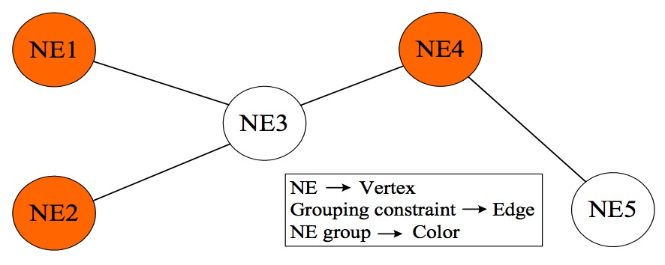
NE grouping: greedy coloring approach
Convert to graph
  Each NE → vertex
  Put edge between two NEs, if they have disjoint permissible interval in any hour
Apply graph coloring
  Minimum number of colors (NE groups) assignable to each vertex (NE) such that no edge (common intersection) connects two identically colored vertices (NE group members)
      We apply the Welsh-Powell coloring algorithm that uses at most one more than the maximum degree of the graph
Notes:
First stage is NE grouping, which identifies NE groups each showing similar threshold behavior each hour among its members.
We perform NE grouping via graph coloring.
We first convert our problem instance to graph such that each NE maps to vertex, and put an edge between two NEs if they have disjoint permissible intervals in any hour.
Then the NE grouping problem thus naturally reduces to the graph coloring that asks the minimum number of colors (NE groups) assignable to each vertex (NE) such that no edge (common intersection) connects two identically colored vertices (group members).
We apply the well-known Welsh- Powell algorithm that uses at most one more than the maximum degree of the graph.

Slide 13
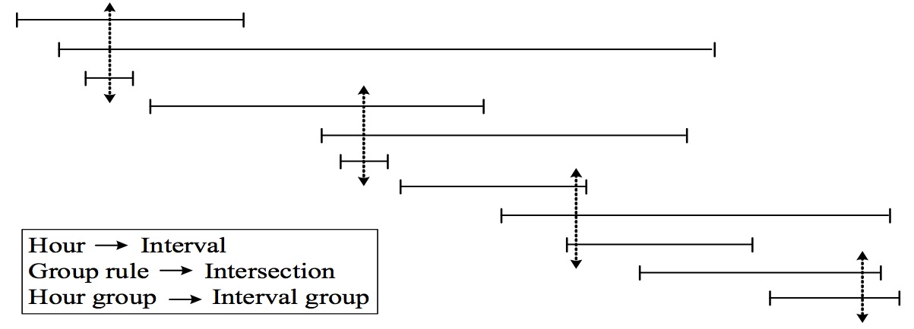
Hour grouping: minimum cover selection
Convert to intervals
  Each hour → its threshold (permissible) interval
Do minimum cover
  Find the minimum number of interval groups such that there is common intersection in each interval group
    Sort all the interval endpoints
    Scan until first encountering an upperbound point
    Put all intervals containing this point in to a new interval group
    Repeat from step 2
Notes:
As the next level of the clustering hierarchy, the time-domain clustering takes the NE grouping result as input to perform the hour grouping for each identified NE-group.
Within NE group, there are initially 24 hour-groups, each of which we simply refer an hour.
Each hour has its own threshold permissible interval.
Now, finding minimum # hour groups is the same as finding the minimum number of interval groups such that there is common intersection in each interval group.
We use a simple greedy algorithm that leads to an optimal solution to this problem.
We first sort all the interval endpoints in ascending order of their values.
We scan the list until first encountering an upperbound point.
We then put all intervals containing this point into a new interval group, and delete them from the list.
We repeat this process until there is no interval in the list.
With these stages, we obtain the compressed threshold setting while still preserving the location and time specific trends, hence the desired alarm accuracy.

Slide 14
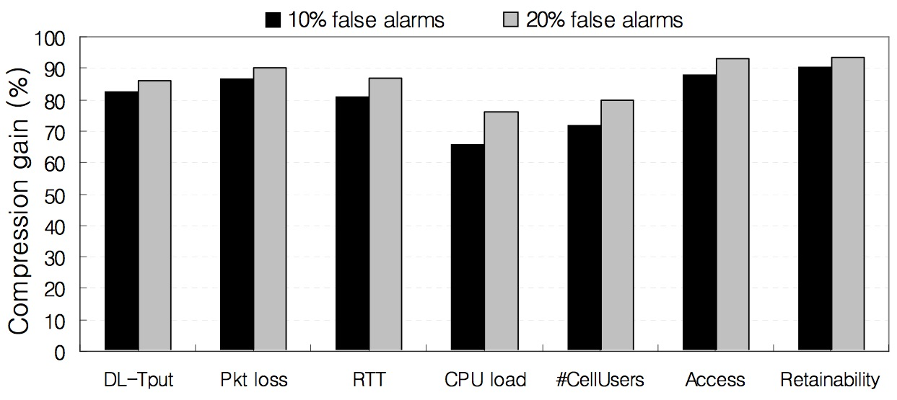
Evaluation: compression gain & alarm quality
Compression gain on various KPIs
(Training dataset 2010/06 – 2010/08)
Within desired 10% false/miss alarm*, nearly 70-90% compression gain
  *In this study, we use slightly different definition of FPR = FP/(FP+TP) and FNR = FN/(FN+TP), to adapt them to the context where TP is much smaller than TN
Notes:
We first evaluate our solution with training dataset from 2010/06 to 2010/08 on various KPIs.
We observe that, within 10% false/miss alarm condition, most KPIs show very high compression gain nearly 80–90%.
Consulted by the operations team, we consider a 10–15% FPR still within the acceptable false alarm range.
Note that in this study, we use slightly different definitions of FPR = FP/(FP+TP) and FNR = FN/(FN+TP), to adapt them to the context where TP is much smaller than TN.

Slide 15
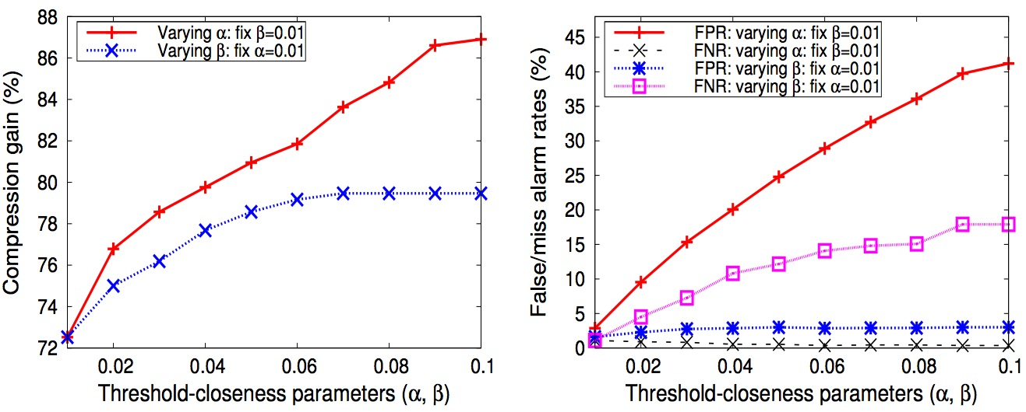
Evaluation: compression gain & alarm quality by tuning input parameters
DL-throughput KPIs
    These give us a clear idea of how α and β should be chosen
      E.g., setting α=0.03 and β=0.04 meets the target FPR (<15%) and FNR (<10%), which leads to compression gain of 82%
Notes:
HEYAN: I guess that you can probably skip this slide (due to time constraint?)
Here’s trend of compression gain and alarm quality by tuning input parameters.
These results give us a clear idea how to chose those parameters to meet our requirements.
For ex, setting α=0.03 and β=0.04, we can meet the target FPR (<15%) and FNR (<10%), which turns out to lead to compression gain of 82%.

Slide 16
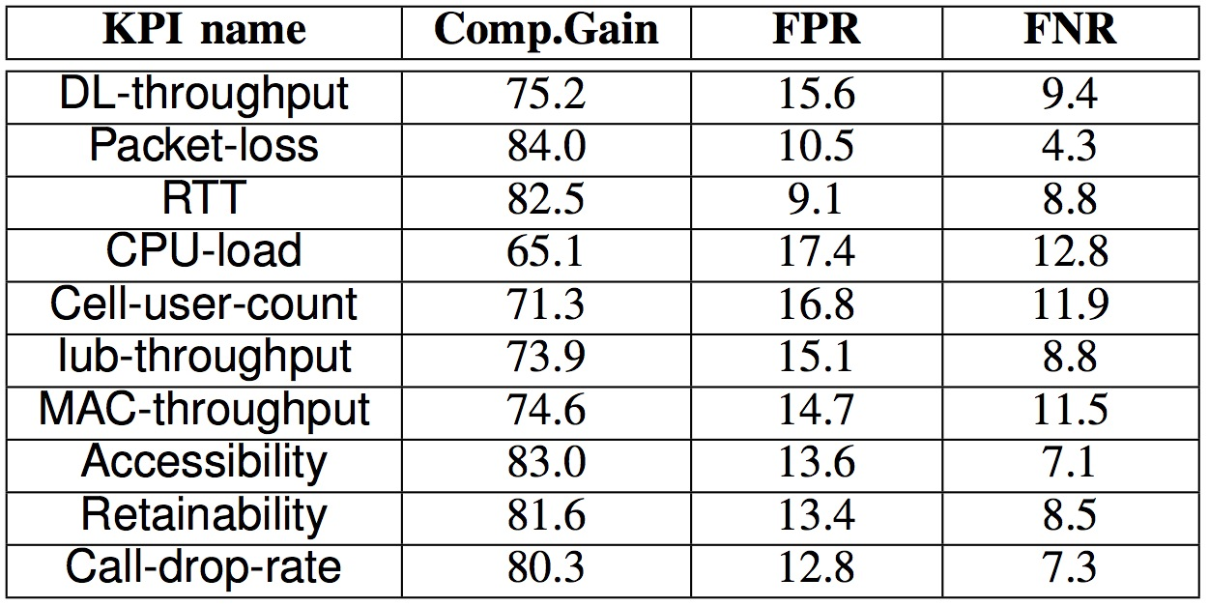
Validation: operational experience
Validation results on various KPIs
(Applying the compressed threshold setting
to real data 2010/08 – 2010/10)
The resulting FPR and FNR are within our target 10-15%
Notes:
Now, in order to validate our results, we applied the compressed threshold settings (derived from the training dataset) to the real data 2010/08 – 2010/10 period, to see whether the pre-generated compressed thresholds still retain the desired alarm quality when applied to the real system
Actually, the results are quite promising. We see that the resulting FPR and FNR are within (or very close to) the range of our desired alarm accuracy for all KPIs.

Slide 17
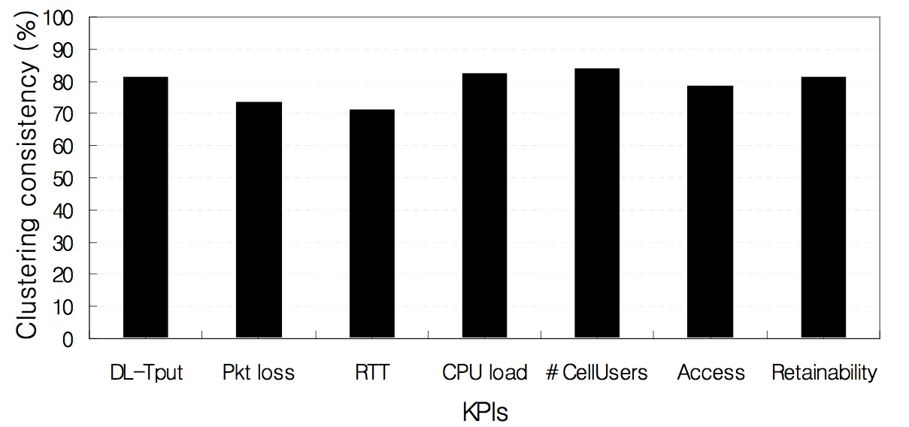
Validation: clustering stability over time
Spatial-temporal clustering consistency between training data
and monitoring data on different KPIs
All KPIs show above 70% consistency → robustness of the solution
  Similar behavior across locations are consistent over time
  Members in each identified cluster behave very closely one another across time, just like one single entity → key idea of our solution
Notes:
Lastly, we also demonstrated the robustness of the solution by examining the clustering consistency between two datasets.
Here the definition of Clustering consistency is the ratio of #members in same clusters in both data sets to the #total members in data.
We observe that the clustering results are quite stable. All KPIs show above 70% consistency.
This stability results explain the good operation experience results in the previous slide.
Also, this stability results can be interpreted as follows.
The similar behaviors across locations are consistent over time. That is, the members in each identified cluster indeed behave very closely one another across time, just like one single entity, which is the key idea of our threshold-compression solution.

Slide 18
Conclusion
3G monitoring is challenging due to its large scale and strong dynamics in both in time and spatial domains
  Tradeoff: threshold setting vs. alarm quality
We propose an intelligent threshold aggregation solution
  Characterizes the location- and time-specific threshold trend of each individual NE with minimal threshold setting
Operational experience with applying our solution has been very positive
  Threshold setting reduction up to 90% with less than 10% false/miss alarm rates
Notes:
In conclusion, 3G network monitoring is very challenging due to its strong dynamics in both time and spatial domains.
There exists a fundamental tradeoff between the size of threshold settings and the alarm quality.
Motivated by key observations of spatial-temporal threshold similarity, we have proposed a scalable monitoring solution, that can characterize the location- and time-specific threshold trend of each individual NE with minimal threshold setting.
Our experience with applying our solution in the operational 3G network monitoring has been very positive, e.g., threshold setting reduction up to 90% with less than 10% false/miss alarm rates.

Slide 19
Backup slides

Slide 20
Common practice for monitoring for a large-scale network
Pre-defined (compute offline) thresholds is preferable
Why not use a more sophisticated realtime-based dynamic thresholding? (e.g. exponential smoothing, regression analysis)
  If applied to each individual node in the network, it will create excessive computational burden on the monitoring system.

Slide 21
Pre-computing thresholds
First pass: remove anomalies.
  Holt-Winters algorithm
    taking into consideration diurnal, weekly pattern etc and individual network elements
Second pass: compute thresholds.
  compute the mean and standard deviation based on the data without anomalies, and then compute thresholds:
    Yellow threshold: (mean – std) for dip KPIs (e.g. throughput), (mean + std) for spike KPIs (e.g. loss)
    Red threshold: (mean – 2*std) for dip KPIs (e.g. throughput), (mean + 2*std) for spike KPIs (e.g. loss)

Slide 22
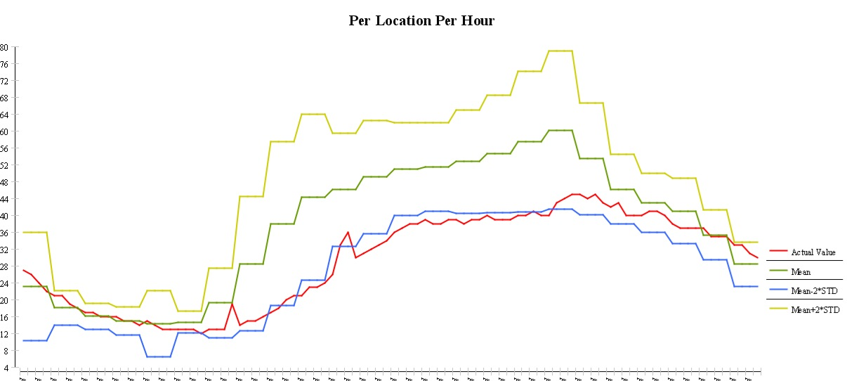
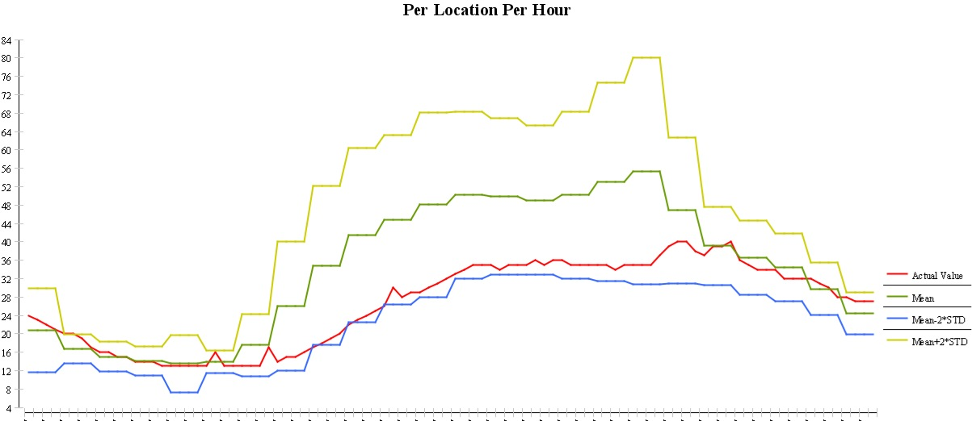
Observation of similar threshold behavior
(Optima KPI: RNC CPU load)
NRCSGAJTCR0R03:ATLNGAUYRNC001|9:10:11:12:13:14:15|14|64.56
  Previously 14 thresholds can become one threshold
Grouping across NEs
across hours
RNC1: NRCSGAJTCR0R03
RNC2: ATLNGAUYRNC001
These two RNCs are under the same SGSN…

Slide 23
Overall picture
For each KPI, the algorithm outputs the compressed thresholds with NE & hour grouping results
Threshold
computation
Threshold
compress
algorithm
Output
Input
(HW)
remove
anomalies
Dynamic
thresholds
(per-NE
hourly)
Compressed
thresholds
(with NE&hour
Grouping results
in XML format)
KPI
data
Compute
Thresholds
dip:mean-2*std
spike:mean+2*std
Output format:
1) Consistent NE grouping over hours
2) Three hourly-groups per NE group
(RNC 1, RNC 2, RNC 3) ; (0am ~ 8 am) : thld 1
(RNC 1, RNC 2, RNC 3) ; (9am ~ 5 pm) : thld 2
(RNC 1, RNC 2, RNC 3) ; (6am ~ 12 pm) : thld 2
(RNC 6, RNC 8, RNC 9) ; (0am ~ 7am) : thld 3
(RNC 6, RNC 8, RNC 9) ; (8am ~ 7pm) : thld 4
(RNC 6, RNC 8, RNC 9) ; (8pm ~ 12pm) : thld 4
Threshold
Closeness
(tunable
parameter)

